Slide 1
R Markdown to Quarto: Supporting Reproducibility
Databases to Dashboards
Lesson 1

Slide 2
Lesson Objectives
Discuss the benefits of using reproducible formats such as R Markdown and Quarto
Create an R Markdown document that includes text and code output
List 2 differences between Quarto and R Markdown

Slide 3
Reproducibility is a best practice for data analysis
“Everything you do, you will probably have to do over again.”
(Noble WS. A quick guide to organizing computational biology projects. PLoS Comput Biol. 2009 Jul;5(7):e1000424.)
Someone else may need to run your analysis
You will want to run the same exact analysis or a very similar analysis in the future
You may want to improve on that analysis

Slide 4
“Literate Programming” supports reproducibility
Programming paradigm introduced by Donald Knuth in 1984
Source code and plain text explanation of code are integrated in one location
Intent = explicitly state the thought process behind the program
Tied to the concept of the “notebook” in modern data science practice

Slide 5




R
Programming language for
data analysis
RStudio
Interactive development environment (IDE)
R Markdown
Computational document format
Quarto
Computational document format
Notes:
I’m sure you all are excited to get started programming and we will do that in just a few minutes.
Before we do that I want to introduce you to 3 items.
The first is R. R is a programming language for data analysis. There are lots of great things about R: it is freely available, great for wrangling data, and very capable for producing impressive visualizations. There is also a great community of folks using it for data science, and we are excited to welcome you all to the R community via this course.
(**) Then, there’s RStudio. RStudio is the name of a free piece of software made by the company Posit (formerly known as RStudio). You can think of RStudio as a sophisticated text editor for writing R code. You can run RStudio on Mac or Windows, or on a server.
(**) Finally there’s R Markdown. (**) Or at least that what we used to say when we taught this course. The next generation of R Markdown known as (**) Quarto was recently released. Quarto is a computational document format that has executable code. Quarto also includes capabilities for annotating your work which is incredibly handy and supports multiple programming languages for mixing and matching code.
And if you are interested in hearing more about Quarto, don’t forget to join JJ Allaire Quarto keynote on Thursday August 25th.
R, RStudio, and Quarto synergize for a robust ecosystem for performing data analysis.

Slide 6
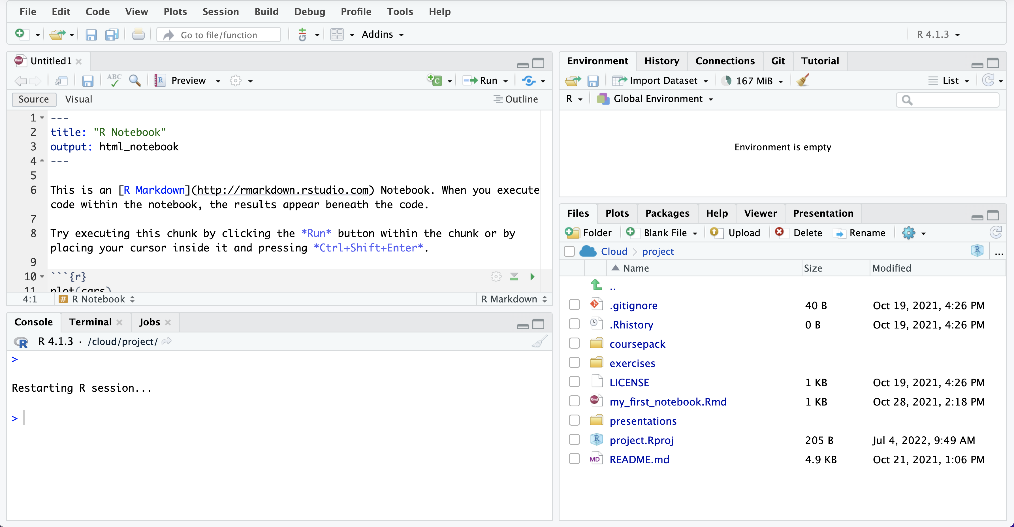
EDITOR
ENVIRONMENT
CONSOLE
MISC
Notes:
Here’s what the RStudio window looks like.
On the top left is the editor. This is where you enter code.
On the top right is the Environment. The environment allows you to look at the data that’s loaded into R. Interacting with data in the environment tab provides some of the functionality you may be familiar with from working in Excel.
The Console is on the bottom left. You can use the console quickly run an individual R command, like install a package. We won’t use the console in this course.
The pane we have labeled “MISC” has a few of tabs. The most important one for today is the “Files” tab which shows the files we’ll be using for the course.

Slide 7
check Before Starting
Go to your Console within Rstudio
Run getwd()
Double check that:
Your working directory is the directory of the project you created
There are no spaces in the path of your working directory

Slide 8
Notes:
R Markdown provides us with features and tools to tackle the reproducibility problem.
In R Markdown, we can craft computer code mixed in with narrative annotation that documents the purpose of the code and details about the decisions we made in our analysis.
R Markdown provides a lab notebook interface for analysis, visualization, and annotation of our work.
It is quickly becoming the gold standard for reproducible data analysis. In the course we will teach you to use R Markdown and we encourage you to continue using it consistently in your future work. In fact, it is the strongest recommendation we will make to you today.

Slide 9
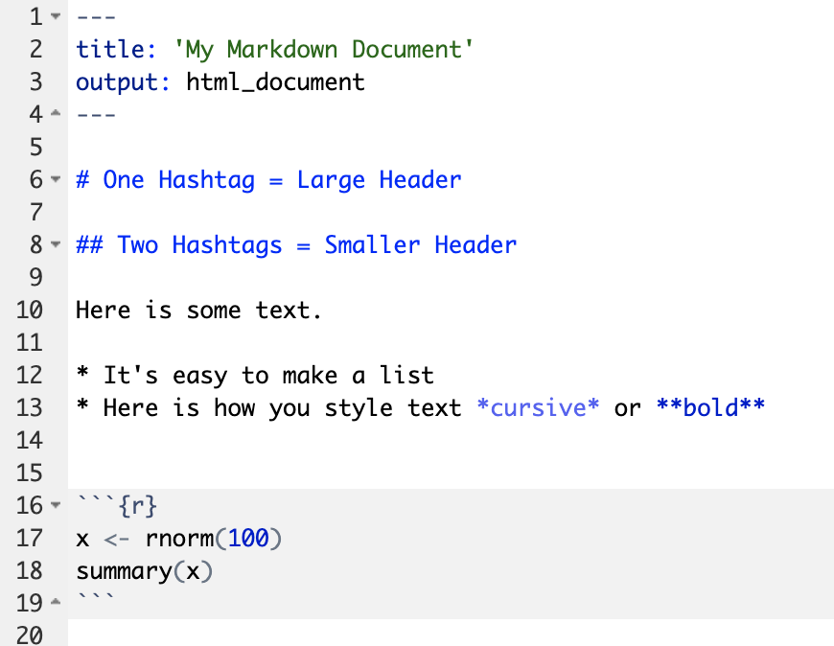
Anatomy of an R Markdown Document
Header
Header
Text (with marks)
Code chunk
Notes:
R Markdown documents are composed of 3 basic building blocks.
**The first is the Header which includes pieces like the name of the document, the document’s author, and the desired output format when the document is assembled.
**The second block is the text. R Markdown documents can be marked in ways that promote readability with various formatting styles.
**Finally, there are code chunks. Code chunks include include R code that can be executed to output results.

Slide 10
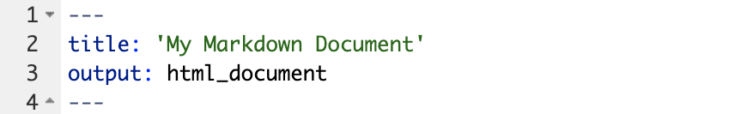
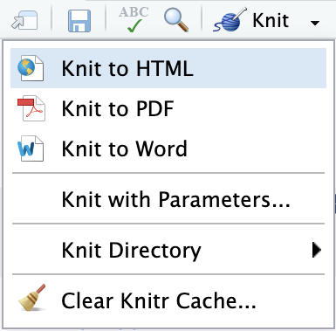
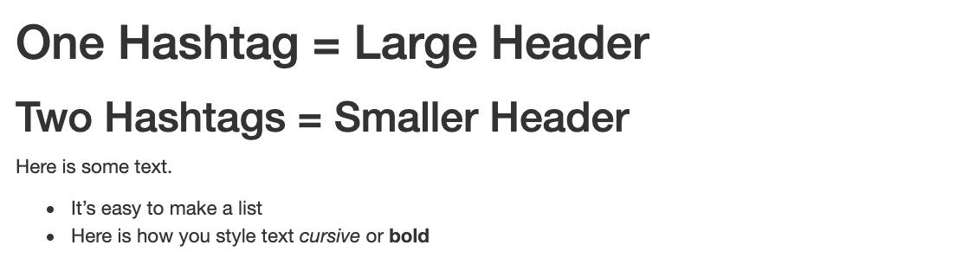
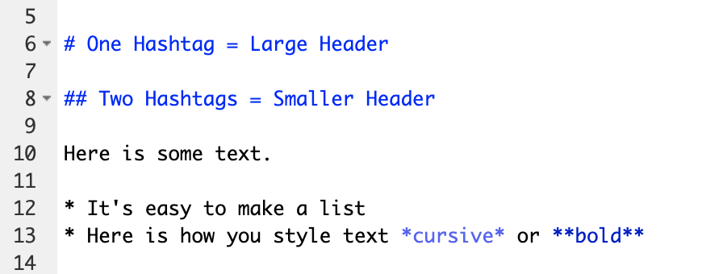
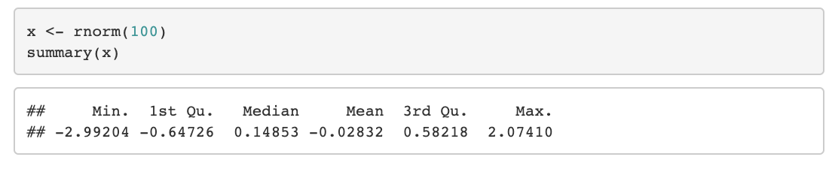
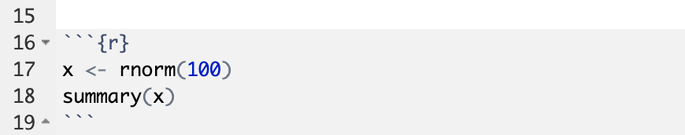
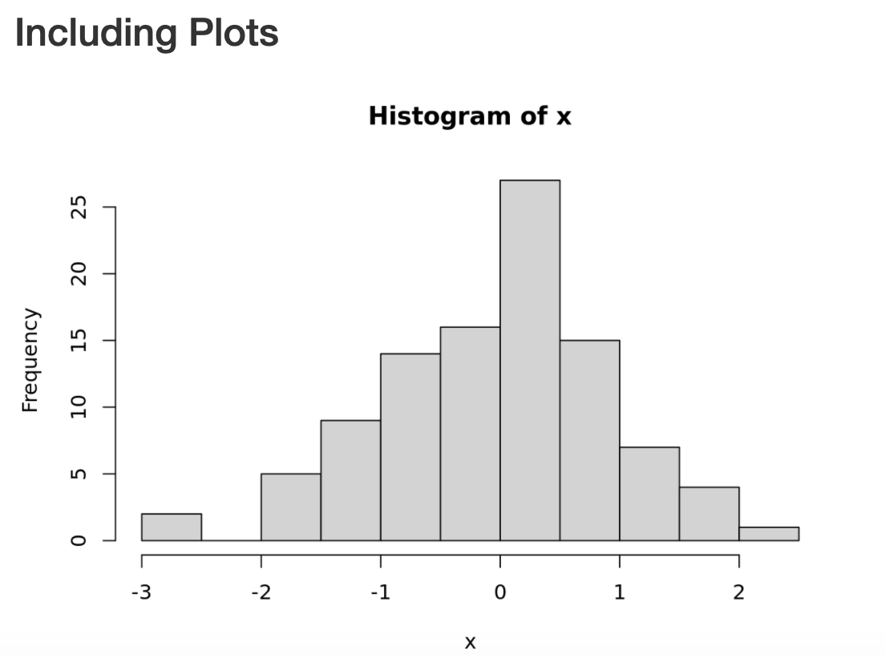
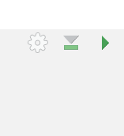
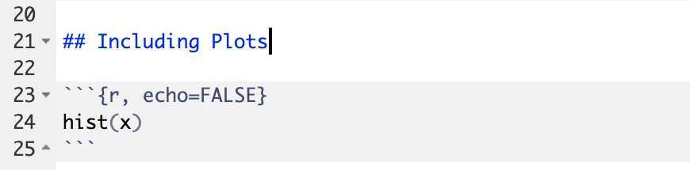
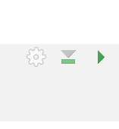
Notes:
Within the R Markdown document, we can execute a single code chunk by ** clicking the “Run Code Chunk” arrow.
And with the click of a button ** (called knitting), we can turn a R Markdown document from this ** to this.

Slide 11
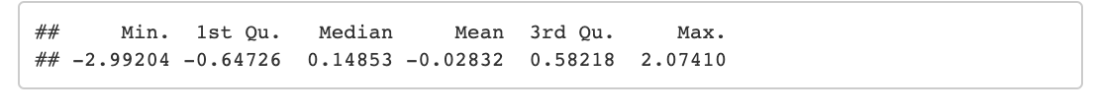
Note how options are added to the chunk
Notes:
Let’s look at this R Markdown document in greater detail.
Again the first block is header section
** The second block includes narrative text with styling applied.
** Then we get to the code chunks (shown in gray boxes). Don’t worry about the grammar of these particular code chunks at this point. In brief the first code chunk generates 100 normally distributed values which are performing a summary on. The knitted document shows us our code ** and the output of that code.
** The second code chunk renders a histogram visualization of that data.
The result is a neatly formatted document that includes an annotated description of our analysis, the code we used, and the output of that code.

Slide 12
Exercise 1
Open a sample R Markdown document (File -> New File -> R Notebook).
Enter a title for the document: “My First Notebook”
Review the format of the document: header, text, code chunks
Execute the individual code chunk by selecting the Run Current Chunk arrow.
Knit the document to HTML (Preview or Knit Button -> Knit to HTML). You will be prompted to save your file first. Name your notebook (my_first_notebook.Rmd) and click save. Review the knitted document.

Slide 13
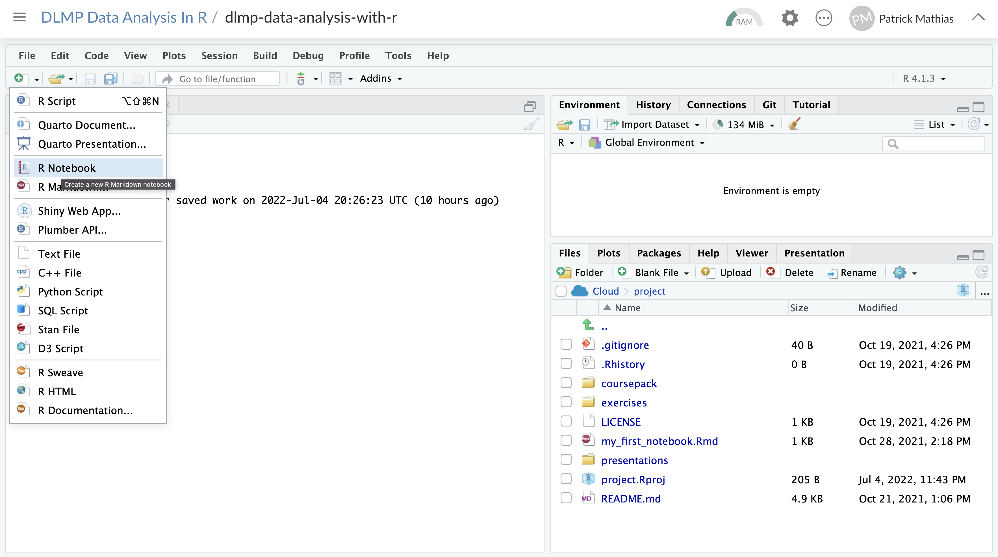

Slide 14
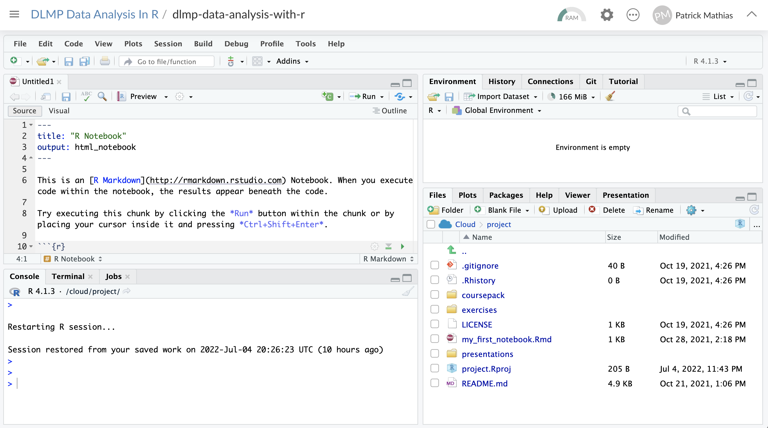
Update title
Scroll down

Slide 15
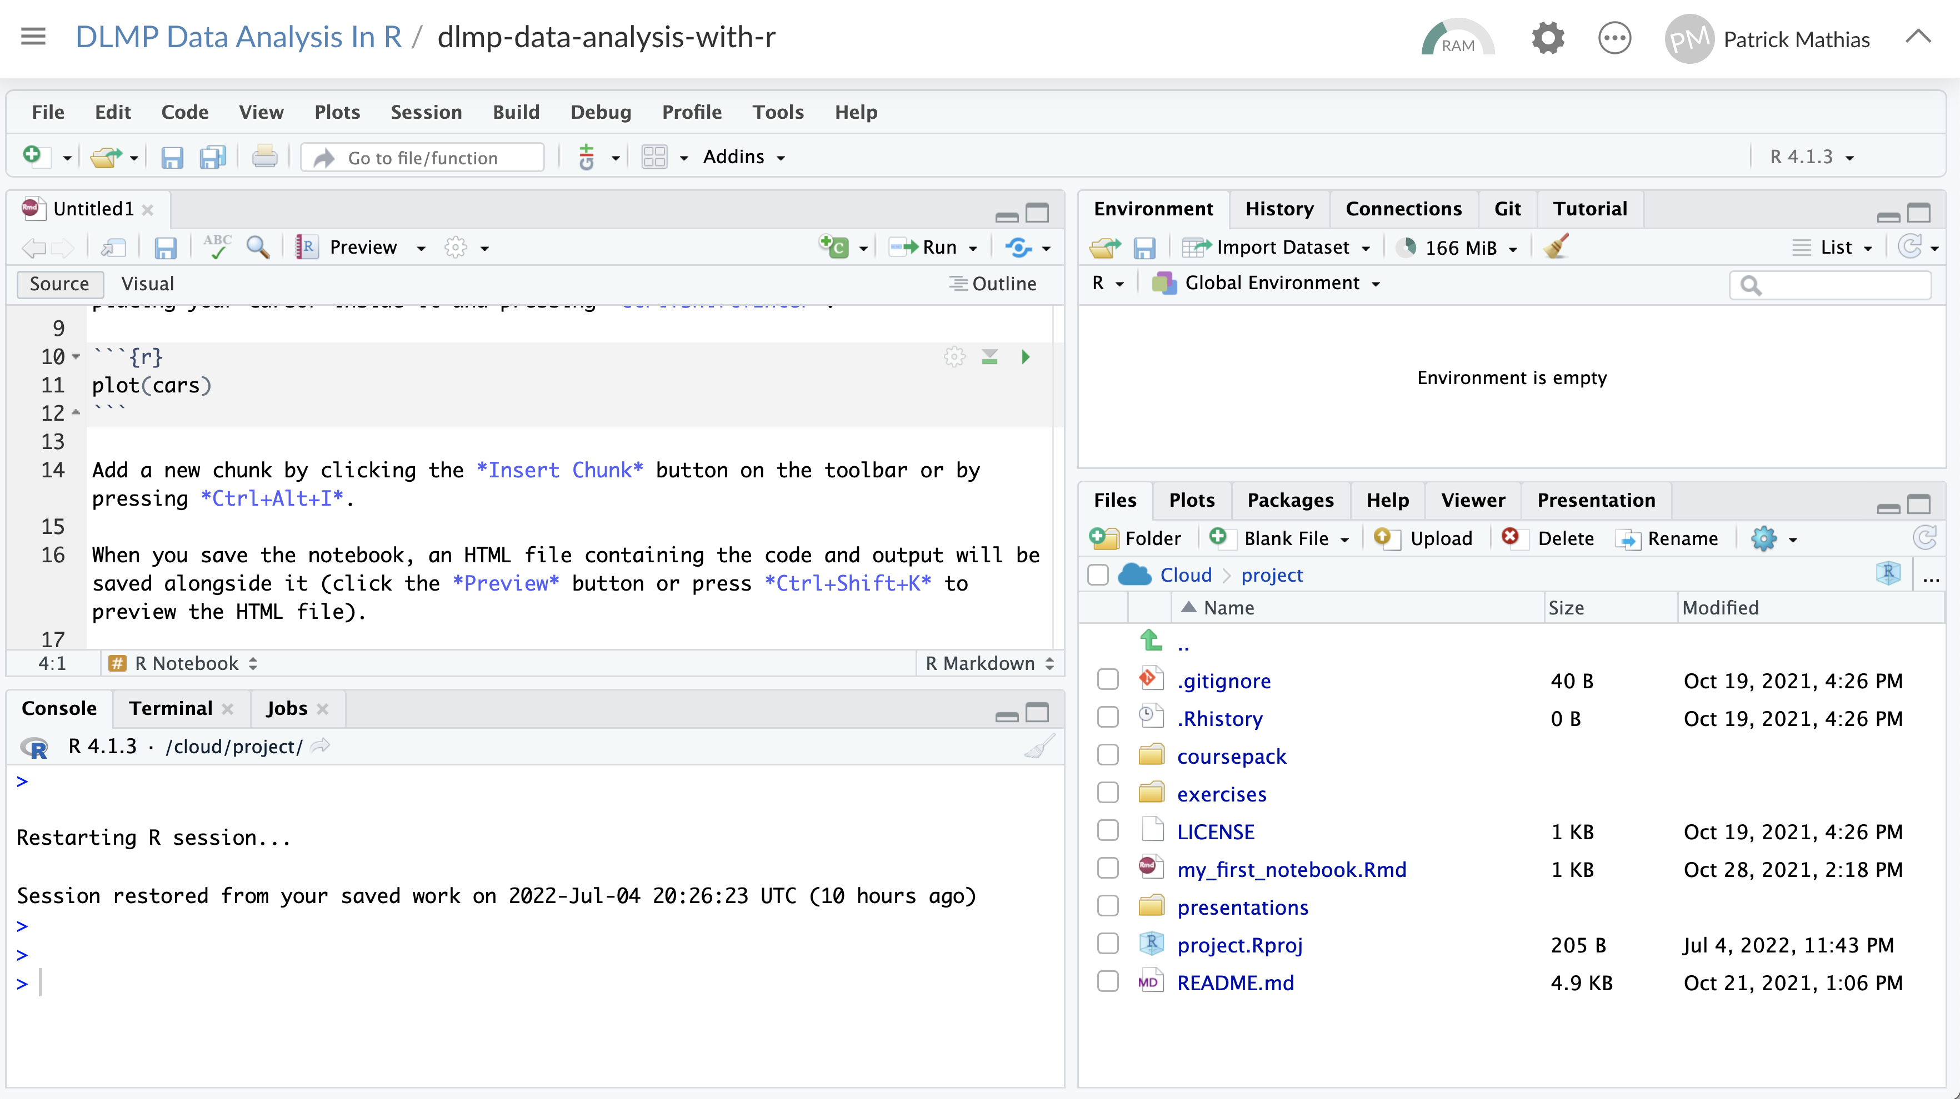
Execute code chunk

Slide 16
Knit document

Slide 17
Exercise 1
Open a sample R Markdown document (File -> New File -> R Notebook).
Enter a title for the document: “My First Notebook”
Review the format of the document: header, text, code chunks
Execute the individual code chunk by selecting the Run Current Chunk arrow.
Knit the document to HTML (Preview or Knit Button -> Knit to HTML). You will be prompted to save your file first. Name your notebook (my_first_notebook.Rmd) and click save. Review the knitted document.

Slide 18
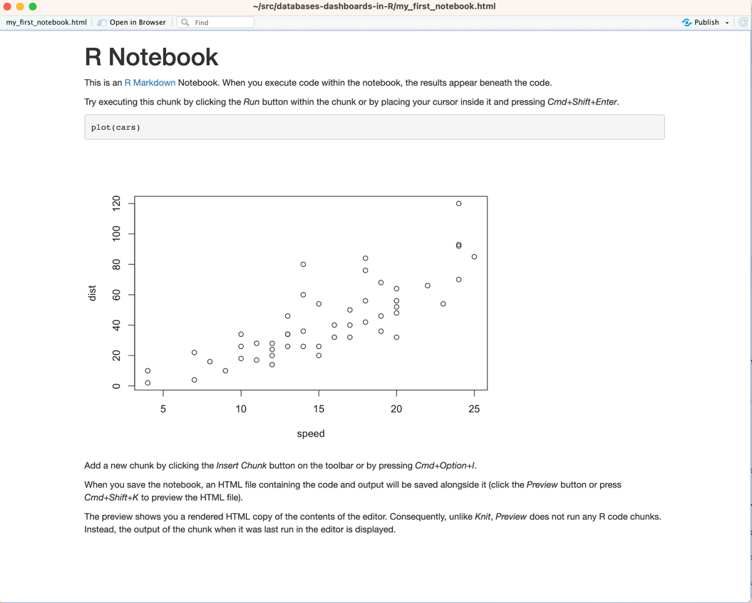

Slide 19
Code chunks
Chunk names must be unique!
Language
Chunk name
Open/close with 3 backticks
Run chunk
Code in body of chunk
Notes:
So where does the code go?
We place these in “chunks” that are executable independently and have a very unique syntax
Backticks (top left of your keyboard) open and close code chunks

Slide 20
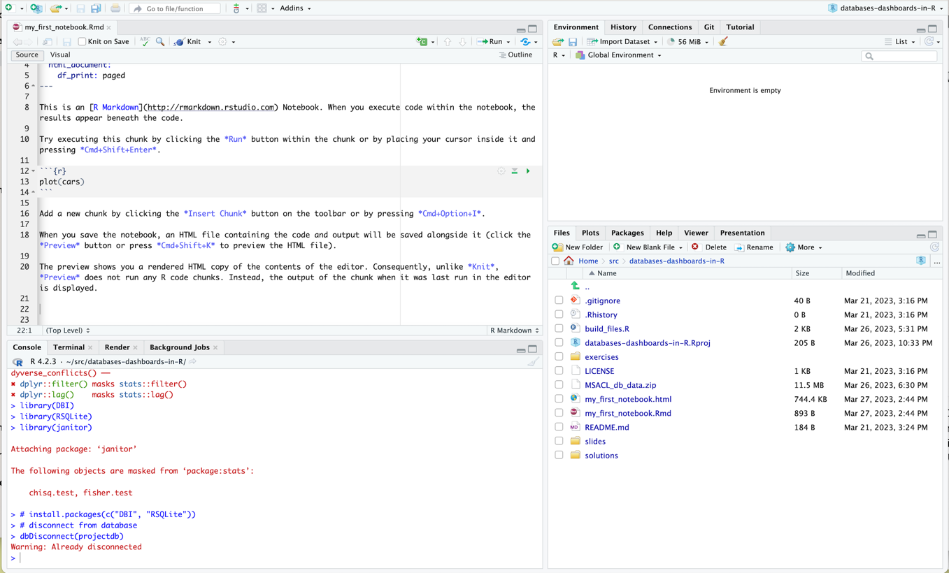
Insert code chunk
Place cursor in document

Slide 21

New code chunk

Slide 22
Shortcuts to Add CoDe Chunks
Windows: ALT + CTRL + i
Mac: CMD + OPT + i

Slide 23
Shortcuts to Execute CoDe Chunks
Windows: CTRL + SHIFT + ENTER
Mac: CMD + SHIFT + ENTER

Slide 24
Exercise 2
At the bottom of your document insert a code chunk into white space using Insert button on top right of code window
Type the following into your new code chunk:
mean(c(10, 20, 30))
Execute code chunk by pressing Run button on top right of code chunk

Slide 25
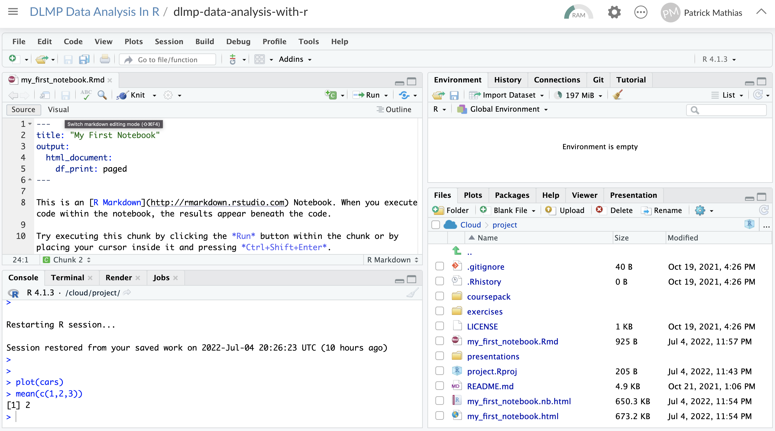
New RStudio Feature: Visual Editor

Slide 26
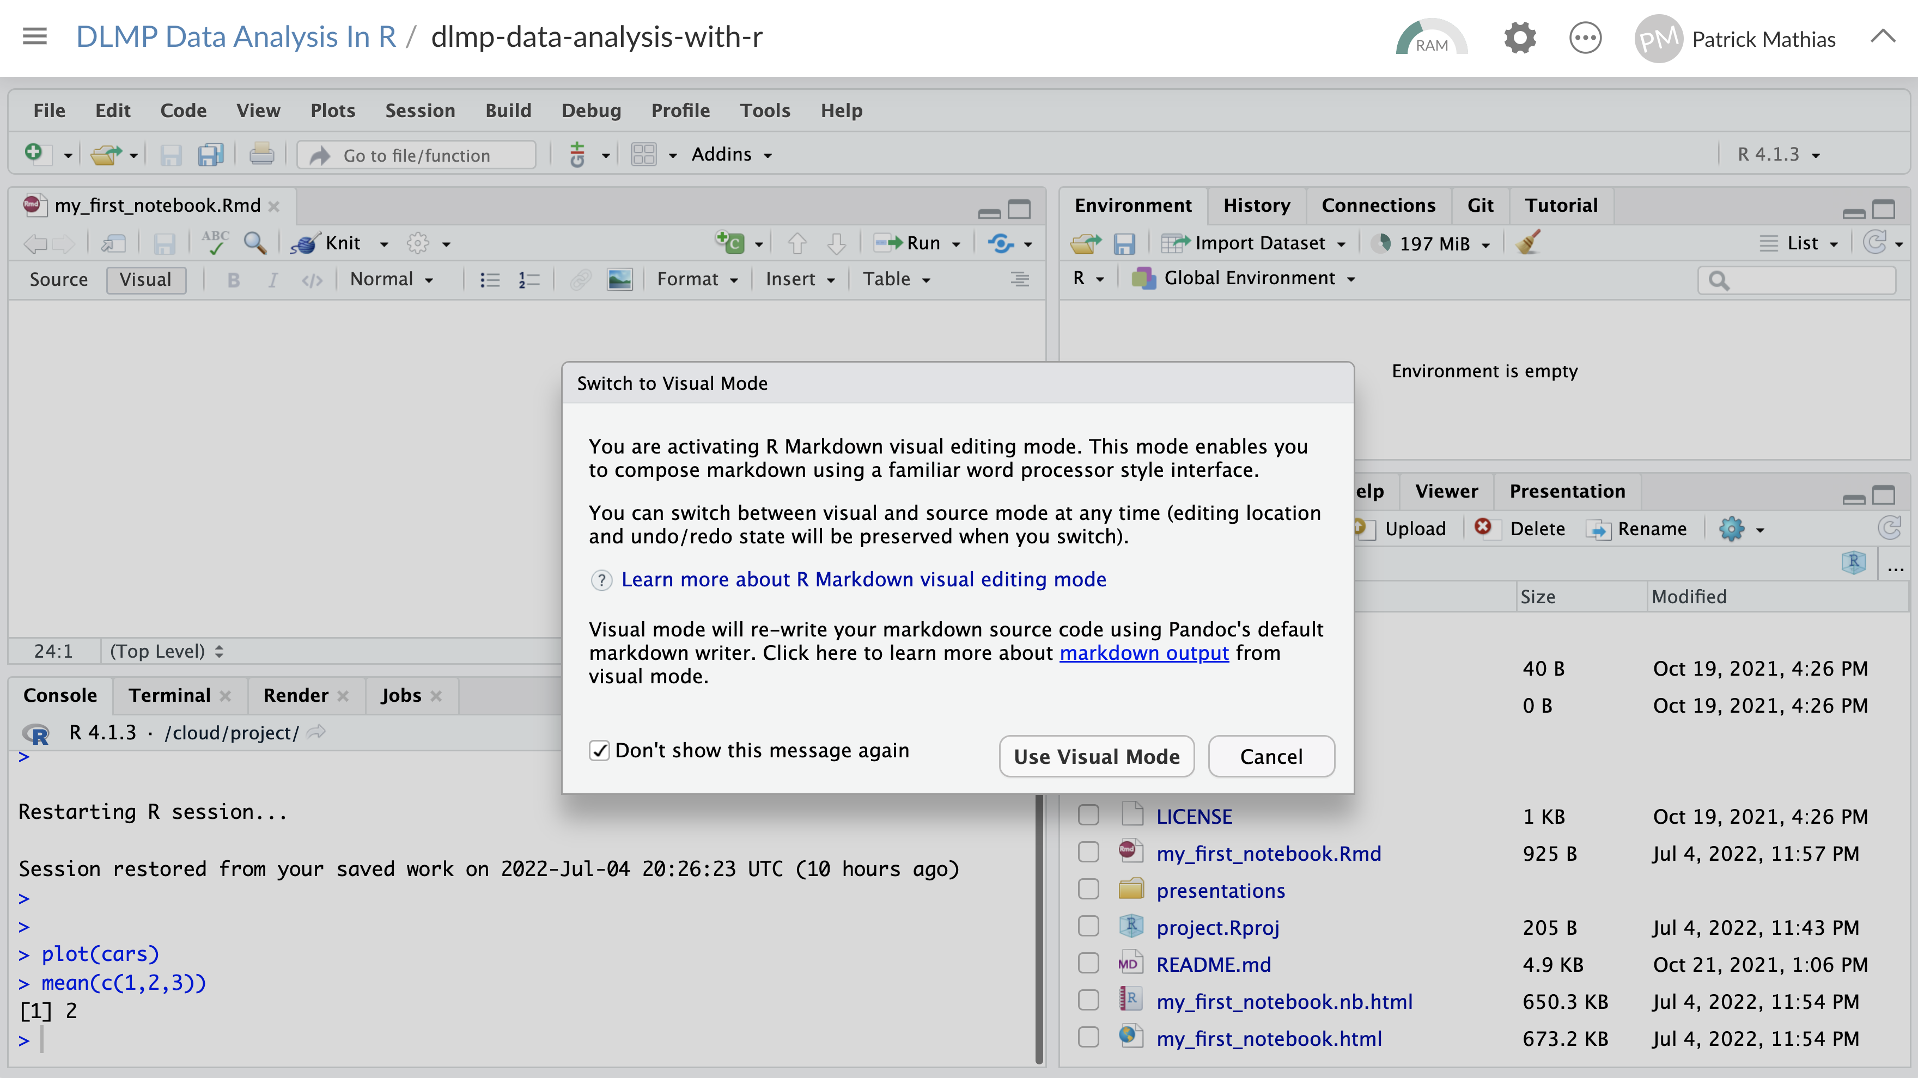

Slide 27
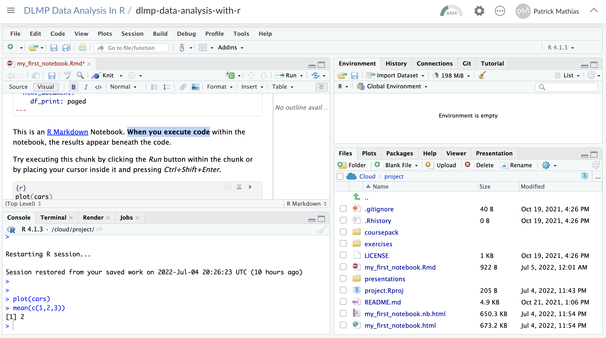

Slide 28
Notes:
R Markdown provides us with features and tools to tackle the reproducibility problem.
In R Markdown, we can craft computer code mixed in with narrative annotation that documents the purpose of the code and details about the decisions we made in our analysis.
R Markdown provides a lab notebook interface for analysis, visualization, and annotation of our work.
It is quickly becoming the gold standard for reproducible data analysis. In the course we will teach you to use R Markdown and we encourage you to continue using it consistently in your future work. In fact, it is the strongest recommendation we will make to you today.

Slide 29

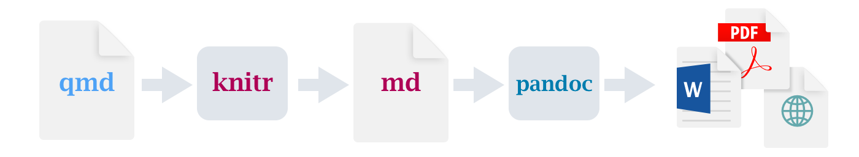
Quarto, Or R Markdown: The Next Generation
https://quarto.org/
Quarto: open-source scientific and technical publishing format
Compatible with multiple languages (Python, Julia, Javascript in addition to R)
Integrated with newest version of RStudio
Expected to be the standard markdown format in RStudio in the future

Slide 30
Exercise 3
Open a new Quarto Document (File -> New File -> R Notebook).
Enter a title for the document: “My First Quarto Document”
Review the format of the document: header, text, code chunks. Note the default to the Visual editing mode.
Execute the individual code chunks by hitting the play buttons in the code chunks. Note the formatting for adding options to the chunk.
Render the document to HTML (Render Button). You will be prompted to save your file first. Name your notebook (my_first_quarto_document.Rmd) and click Save. Review the rendered document.

Slide 31
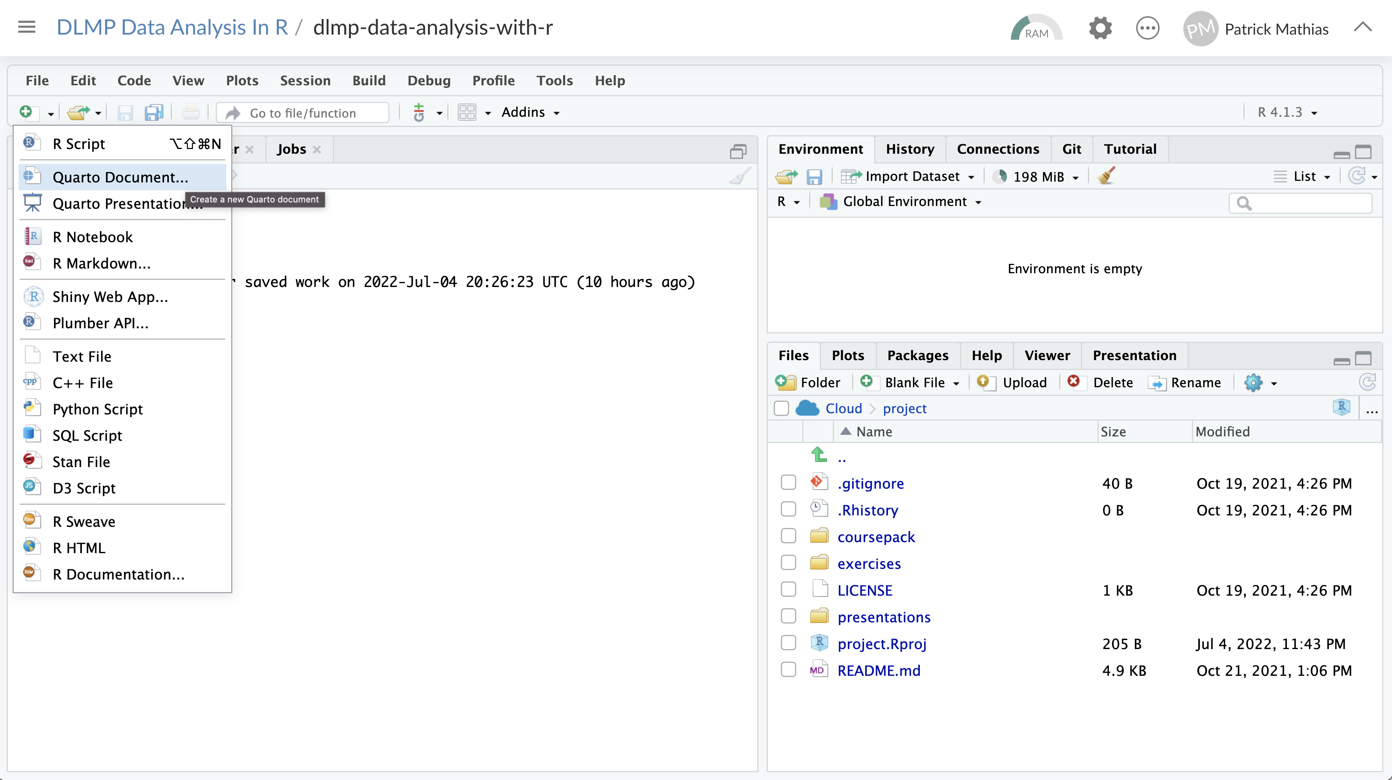

Slide 32
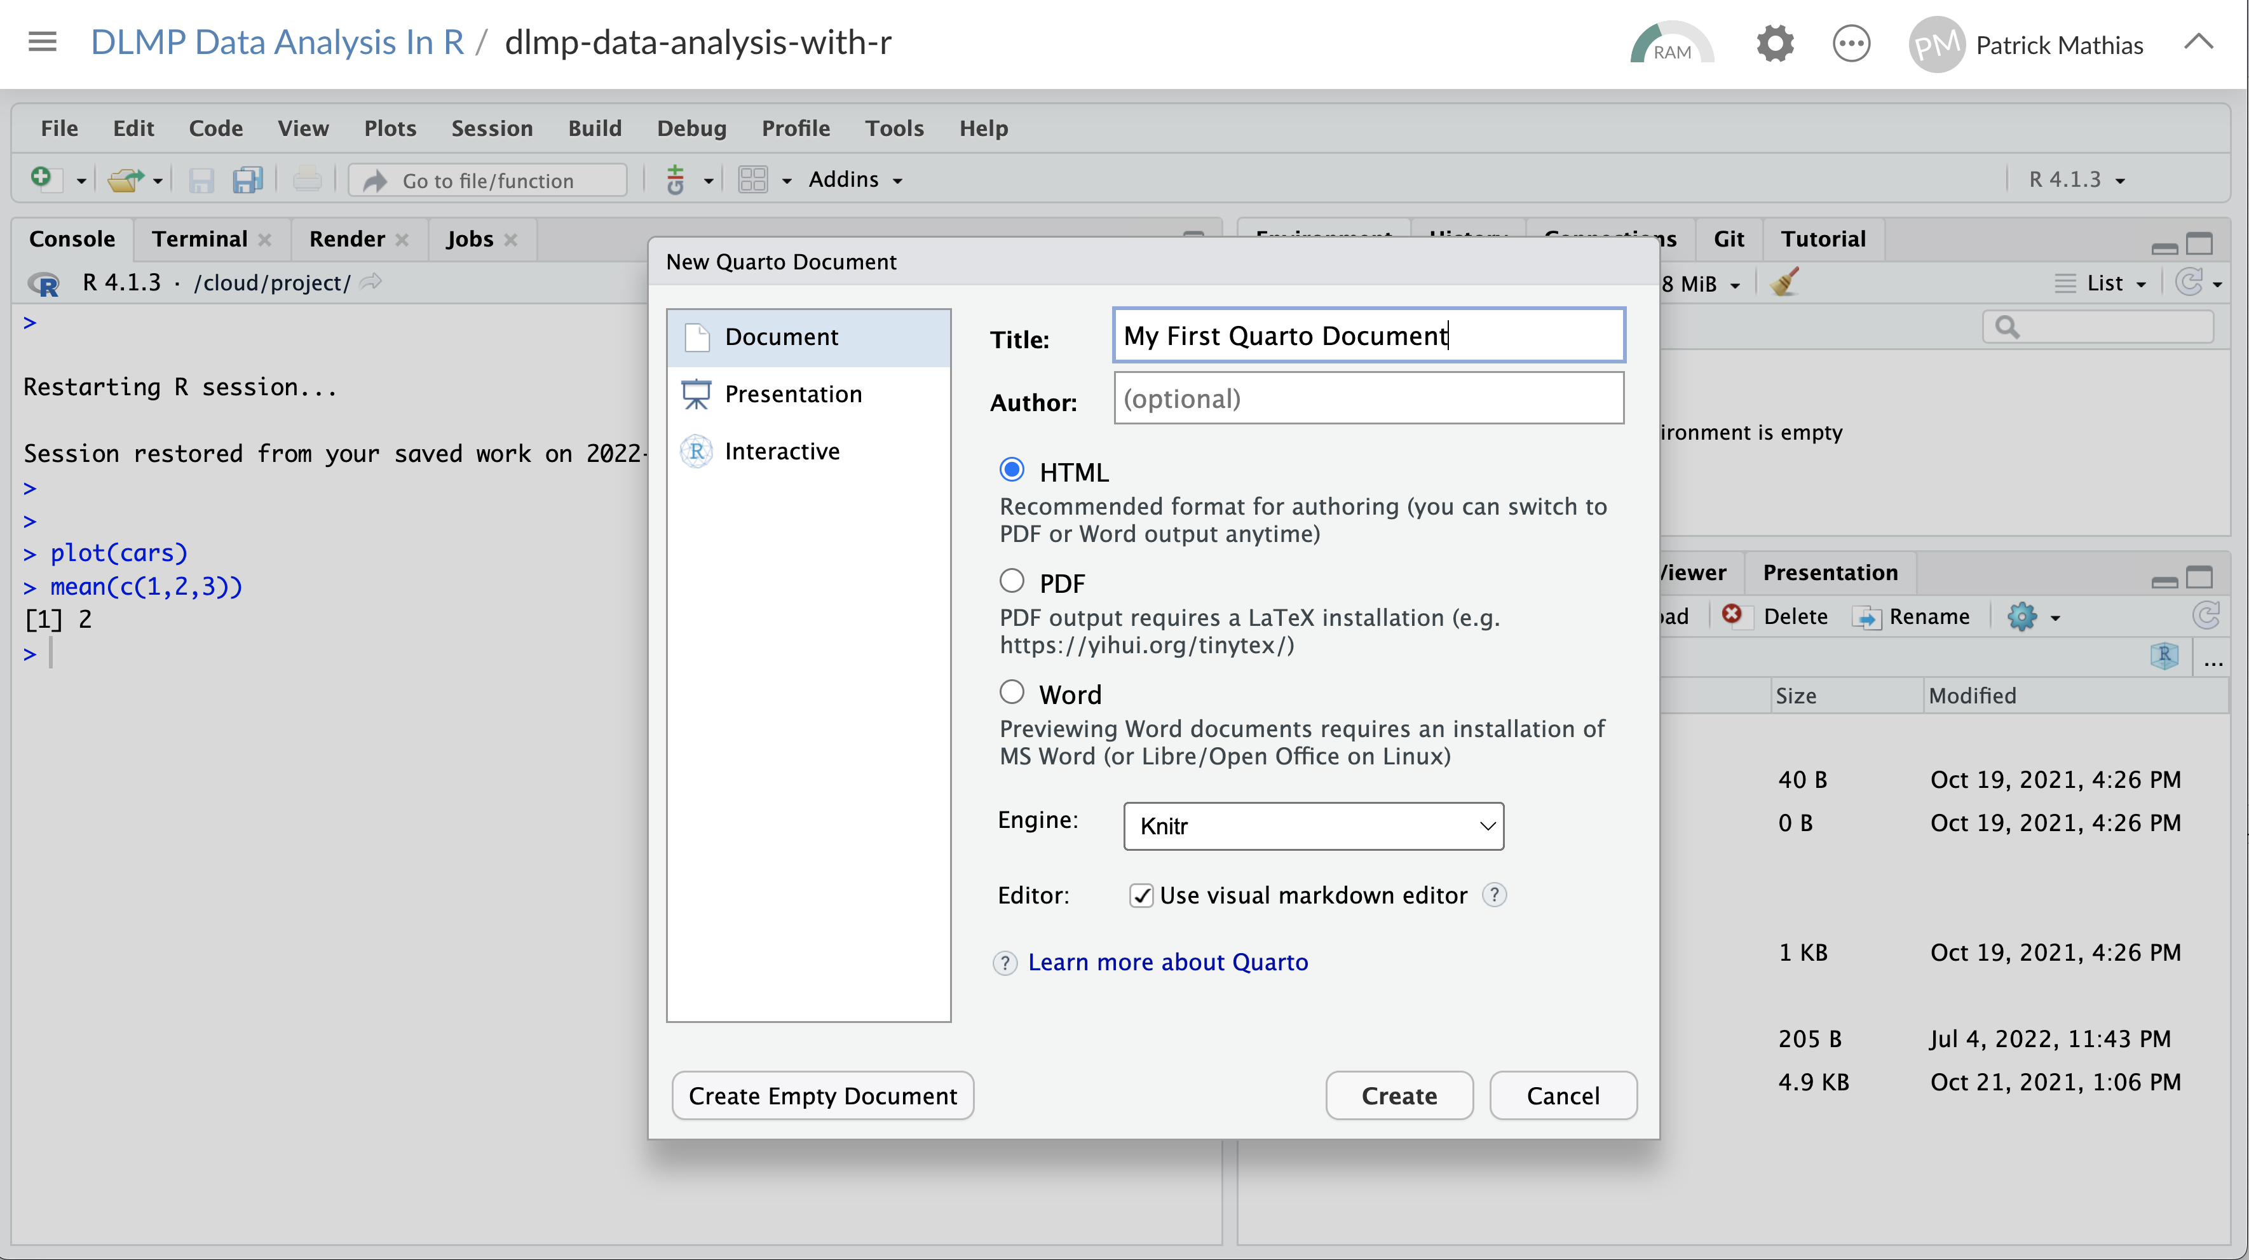

Slide 33
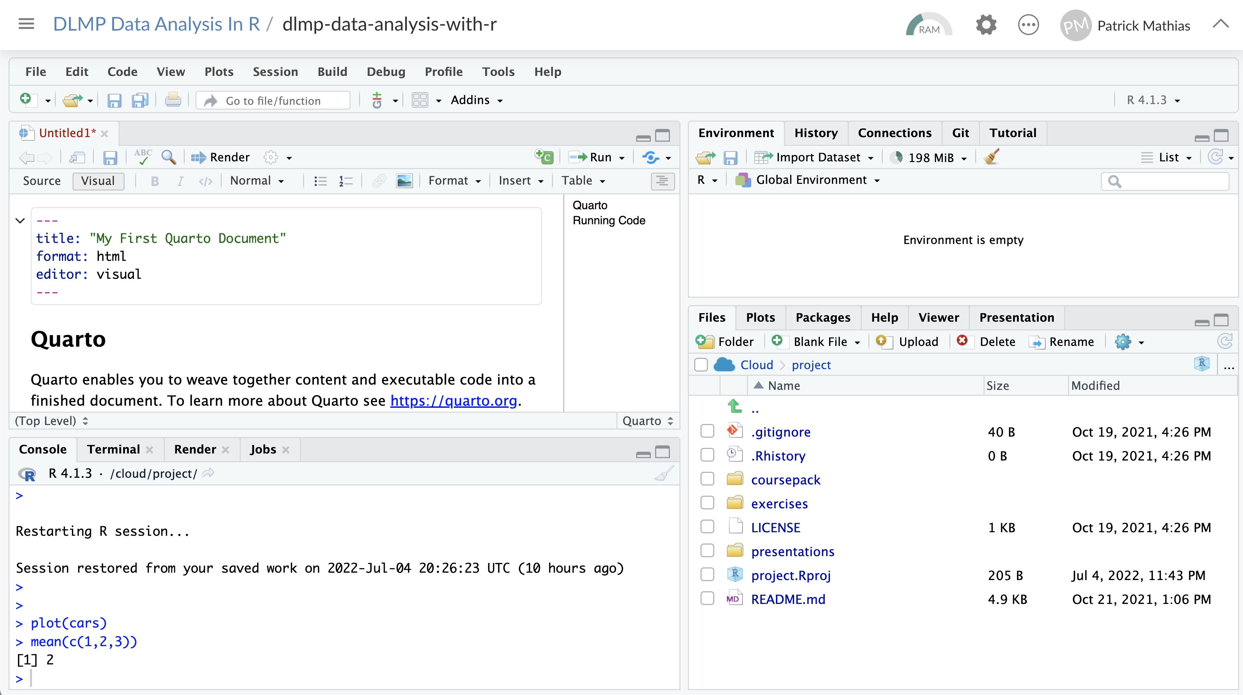

Slide 34
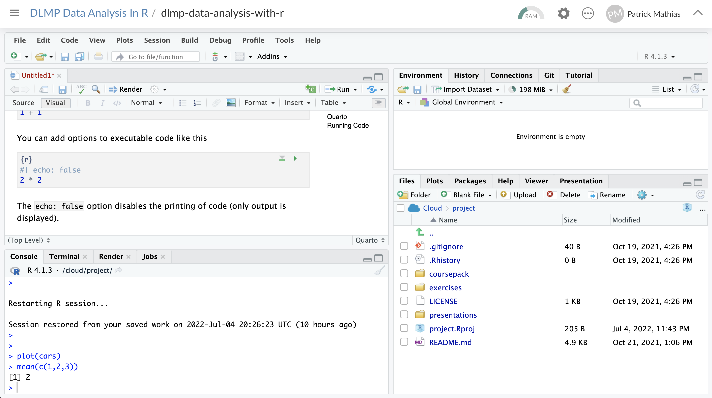

Slide 35
Exercise 3
Open a new Quarto Document (File -> New File -> Quarto Document).
Enter a title for the document: “My First Quarto Document”
Review the format of the document: header, text, code chunks. Note the default to the Visual editing mode.
Execute the individual code chunks by hitting the play buttons in the code chunks. Note the formatting for adding options to the chunk.
Render the document to HTML (Render Button). You will be prompted to save your file first. Name your notebook (my_first_quarto_document.Rmd) and click Save. Review the rendered document.

Slide 36
Additional Quarto Limitations and Features
Not yet integrated with all packages that use R Markdown
Flexdashboard – covered later in course is NOT currently supported by Quarto (but is on the roadmap for support later this year)
Quarto can embed Shiny components and applications to generate an interactive document
Features included tools to author articles (citing references, generating tables, etc.), websites, blogs, and presentation outputs that R Markdown supports
https://quarto.org/docs/faq/rmarkdown.html

Slide 37
When DO I Use Quarto Vs. R Markdown?
R Markdown will continue to be supported by Posit (new name for company that sells RStudio)
Development resources will shift to Quarto – expect to see new features there
Recommendation: Use Quarto by default unless you know need features that aren’t supported, i.e. unless you need to build a dashboard (flexdashboard support is planned)

Slide 38
Lesson Objectives
Discuss the benefits of using reproducible formats such as R Markdown and Quarto
Create an R Markdown document that includes text and code output
List 2 differences between Quarto and R Markdown

Slide 39
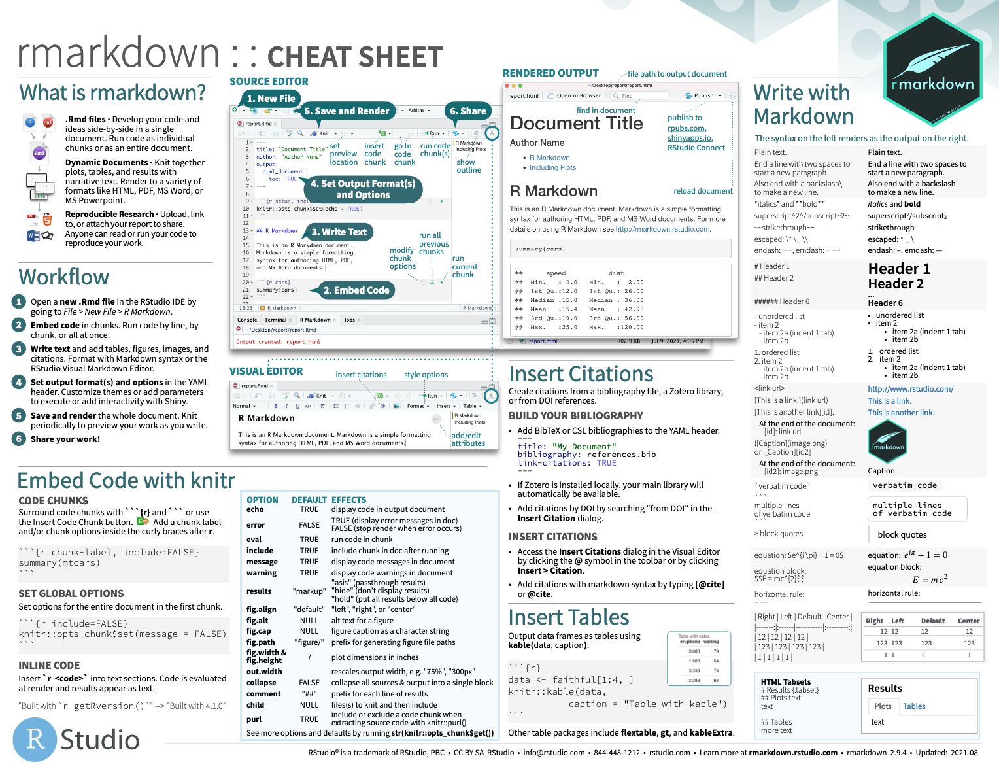
Notes:
The R Markdown cheat sheet helps with the grammar of crafting markdown documents including visual formatting options.
The R Markdown cheat sheet is available on the RStudio website.

Slide 40

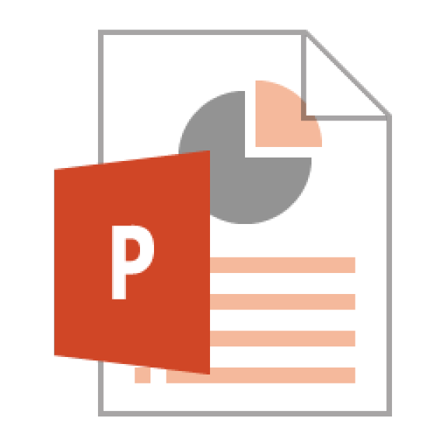



Notes:
In this lesson we practiced “knitting” our analysis to an HTML file.
In addition to HTML files, R Markdown documents can be “knitted” into a number of additional formats including PDF, Microsoft Word, PowerPoint, and even interactive dashboards. We will look at dashboards in greater detail later in the course.

